Slide 1
Simple Plagiarism Detector
Developed by:
Ahmed Elkhodary (900213472)
Omar Gomaa (900221723)
Belal Yasser (900221681)
Supervised by: Dr Howaida Ismail
Fundamentals of Computing II Spring 2023 Term Project
The American University in Cairo
Computer Science & Engineering Department

Slide 2
// Class

Slide 3
// Class definition "PDetector”
class PDetector {
public:
PDetector() {}
int hamming_distance(string s1, string s2) {
int count = 0;
for (int i = 0; i < s1.length(); i++) {
if (s1[i] != s2[i]) {
count++;
}
}
return count;
}
}
// default constructor
// Function for computing Hamming Distance
//between string s1 & string s2
// Initializing the count of mismatches to 0
// Loop through each character in s1
// Validate the characters at current position
// Increment the count of mismatches
// Return the count of mismatches

Slide 4
// Brute Force Algorithm

Slide 5
// Initialize a vector to store the indices of the matching strings
// Store the length of the pattern in m
//Loop through each string in the text
//Store the length of the current string in a variable
// Loop through each substring of the current string with same length as the pattern
// Compute the Hamming distance
//between the pattern and the current substring
//Validate Hamming distance is <= to the maximum distance allowed
//Add the index (k) of the current string to the list of matching strings matches
//Function definition for Brute Force Algorithm
vector<int> brute_force(string pattern, vector<string> text, int max_distance){
vector<int> matches;
int m = pattern.length();
for (int k = 0; k < text.size(); k++)
int n = text[k].length;
for (int i = 0; i <= n - m; i++) {
int distance = hamming_distance(pattern, text[k].substr(i, m));
if (distance <= max_distance)
matches.push_back(k);
}
return matches;
}

Slide 6
// Rabin-Karp Algorithm

Slide 7
// Define the function for Rabin-Karp Algorithm pattern matching
// Initialize a vector to store the indices of the matching strings
// Store the length of the pattern in a variable
// Choose a prime number for hashing
// Choose a large prime number for the modulus
// Initialize the value of p^0 to 1
// Initialize the hash value to 0
// Loop through each character in the pattern
// Update the hash value for the pattern using the Rabin-Karp hash function
// Update the value of p^i
vector<int> rabin_karp(string pattern, vector<string> text) {
vector<int> matches;
int m = pattern.length();
int p = 31;
int mod = pow(10, 9) + 9;
int p_pow = 1;
int pattern_hash = 0;
for (int i = 0; i < m; i++) {
pattern_hash = (pattern_hash + (pattern[i] - 'a' + 1) * p_pow) % mod;
p_pow = (p_pow * p) % mod;
}

Slide 8
// Read file function

Slide 9
string read_file(string filename) {
ifstream infile(filename);
string content((istreambuf_iterator<char>(infile)), istreambuf_iterator<char>());
return content;
}
// Read file into a string
// open the input file stream using the filename
// read the content of the file using iterators and store it in a string
// return the string containing the file content

Slide 10
// Sentences Splitting

Slide 11
// Splitting string into Sentences
vector<string> split_sentences(string text) {
vector<string> sentences;
int start = 0;
int end = 0;
for (int i = 0; i < text.length(); i++) {
if (text[i] == '.' || text[i] == '?' || text[i] == '!') { end = i;
sentences.push_back(text.substr(start, end - start + 1));
start = i + 1;
}
}
if (start < text.length())
sentences.push_back(text.substr(start));
}
return sentences;}
// Empty vector to store the sentences
//initialize the end&start index of a sentence
//loop through each character in the input text
// validate character is the end of a sentence
// set the end index to the current character
// add the sentence to the vector by extracting it from the input text using substr() function
// set the start index to the next character
// Validate last sentence did not end with '.', '?', or '!', add the remaining characters to a sentence
// return the vector of sentences

Slide 12
// Main function
void run()

Slide 13
void run() {
string test_doc = read_file("test.txt"); vector<string> sentences = split_sentences(test_doc); for (int i = 0; i < sentences.size(); i++) {
string sentence = sentences[i];
cout << "Checking sentence: " << sentence << endl;
// Brute force algorithm
vector<int> brute_force_matches = brute_force(sentence, sentences, 3); if (!brute_force_matches.empty()) {
cout << "Matches found using brute force: ";
for (int j = 0; j < brute_force_matches.size(); j++) {
cout << "Doc" << brute_force_matches[j] << " ";
}
cout << endl;
}

Slide 14
// void run() continued
// Rabin-Karp algorithm
vector<int> rabin_karp_matches = rabin_karp(sentence, sentences);
if (!rabin_karp_matches.empty()) {
cout << "Matches found using Rabin-Karp: ";
for (int j = 0; j < rabin_karp_matches.size(); j++) {
cout << "Doc" << rabin_karp_matches[j] << " ";
}
cout << endl;
}
}
}

Slide 15
int main() {
PDetector detector;
detector.run();

Slide 16
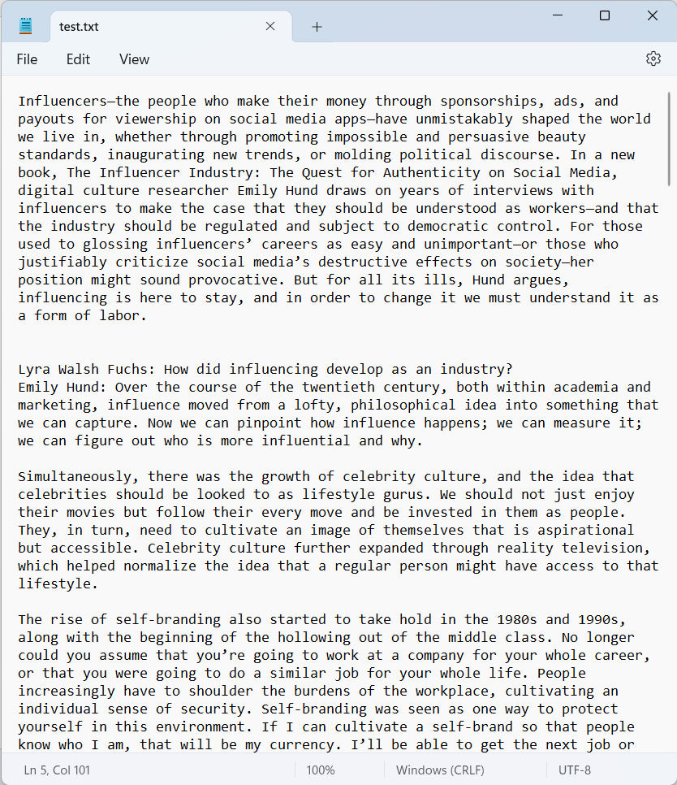
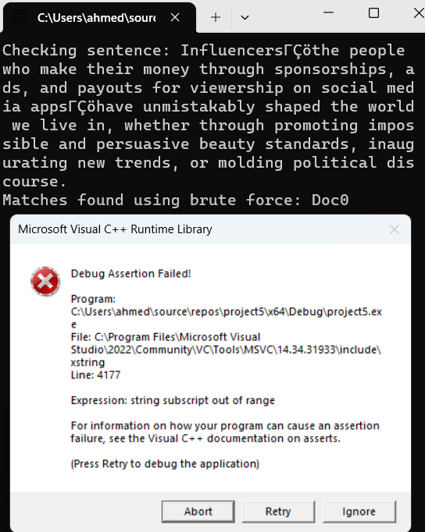



Unsolved Problems

Slide 17

THANKS, AND BYE!

